Slide 1
Lecture 12
Virtual Machines

Slide 2
System Virtual Machines
A (full) system virtualization environment is capable of supporting multiple system images simultaneously, each running its own operating system and associated application programs
Real resources of the host platform are shared among the guest system with the virtual machine monitor (VMM, a.k.a. hypervisor)
Focus on VMs where ISA of the host and guest are the same
Linux
Applications
Windows
Applications
Solaris
Applications
Linux
Windows
Solaris
Virtual
Intel IA-32
Virtual
Intel IA-32
Virtual
Intel IA-32
Virtual Machine Monitor(VMM)
Intel IA-32 Hardware

Slide 3
Other types of virtualizations
High level language virtualization
For cross-platform compatibility, “write once, run everywhere”
Java Virtual Machine
Cross platform emulation
Qemu, Apple Rosetta
OS-level virtualization
Multiple isolated user space instances
Docker

Slide 4
Outward Appearance
To network
Disk
Memory
Printer
Network
Controller
CPU
Terminal
Controller
Shared
Hardware
Dedicated to
user1
Dedicated to
user2
speaker
Keyboard
CD-Drive
speaker
Keyboard
CD-Drive
Display
Mouse
Display
Mouse
Notes:
Using devices such as KVM
Multiple OS share the same input device such as keyboard, mouse , display, etc

Slide 5
State Management
Indirection
VMM Memory
Load register block pointer
To point to VM’s registers
In VMM memory
Load program counter to
Point to VM program and
Start execution
.
.
Load temp <- reg_pointer, index(A)
Store reg_pointer, index(B) <- temp
.
.
Processor
Register values
For VM1
VMM changes
pointer when
VM is activated
Register values
For VM2
Register Block
Pointer
Register values
For VM3
Copying
VMM Memory
Copy register state from
VMM memory
Load program counter to
Point to VM program and
Start execution
.
.
Mov reg A -> reg B
.
.
Copy register state from
Processor back to system memory
Processor
Register values
For VM1
Register values
For VM2
VMM copies register
values when VM is
activated
Processor
Register
Register values
For VM3
Notes:
There might be no adequate resources on the host platform
VMM periodically switches control among the guest VMs
First approach is indirection where VMM match the pointer to the active VM. This is analogous to the situation in virtual memory system.
Second approach is state copying where VMM copy the active VM’s state to the memory and copy it back when a different guest is activated

Slide 6
Resource Control
Adopt time-sharing systems
The VMM maintain overall control of all the hardware resources
The interval timer interrupt
Guarantee that control is transferred back to VMM and the VMM handles the interrupt itself
VMM determines
Next VM to be
activated
VMM restores
architected state
For next VM
Timer
Interrupt
occurs
VMM saves
architected state
Of running VM
VMM sets timer
interval and
enables interrupts
VMM sets PC to timer
Interrupt handler of
OS in next VM
First VM Active
VMM Active
Next VM Active
Notes:
Privileged resources are not used directly by the running VM
VMM emulates all the operation of these resources
The handler for the timer interrupt includes code that saves the state of the current guest virtual machine, determines the next virtual machine that shuld be activated, and load the next virtual machine to be run
The guest OS should not be allowed to read the timer value set by the VMM

Slide 7
Native and Hosted Virtual Machine
Native VM system
A system where a VMM operates in a privilege mode higher than the mode of the guest virtual machines
The privilege level of the guest OS is emulated by the VMM
Hosted VM system
The VMM is installed on a host platform that is already running an existing OS
The VMM utilizes the functions already available on the host OS to control and manage resources desired by each of the virtual machine
Guest Apps
Guest Apps
Guest Apps
Application
Guest OS
Guest OS
Nonprivileged
modes
Guest OS
VMM
VMM
OS
VMM
Host OS
Host OS
Privileged
modes
Hardware
Hardware
Hardware
Hardware
Traditional
Uniprocessor
system
Native
VM system
User-Mode
hosted
VM system
Dual-mode
hosted
VM system
Notes:
For efficient operation of the system, therefore at least some part VMM implementation should have privileges higher than the actual privileges of the guest machines it support
Actual privilege means the privilege the code has on the hardware while it is running in the Virtual Machine environment
Relationship between VMM and virtual machine is analogous to relationship between OS and application in the old traditional system.
In native VM, the VMM is the only software that executes in the highest privilege level defined by system architecture and OS are instaaled on top of the VMM
Hosted system divided in to user –mode and dual-mode
In dual-mode part of the VMM works in privileged or system mode

Slide 8
Resource Virtualization - Processor
The key aspect of virtualizing a processor is the execution of the guest instructions, including both system-level and user-level instruction
Processor virtualization method
Emulation
Interpretation, binary translation
Emulation is the only processor virtualization mechanism for different ISA between the guest and the host
Direct native execution
Only if the ISA of the host is identical to the ISA of the guest
The goal is to gain the same performance as it runs on the virtual machine

Slide 9
Resource Virtualization - Processor Conditions for ISA Virtualizability
We restrict the discussion here to native system VMs
In a native system VM, the VMM runs in system mode, and all other software runs in user mode
The VMM keeps track of the intended mode of operation of a guest virtual machine but it will always use user mode in executing the instructions from the guest virtual machine

Slide 10
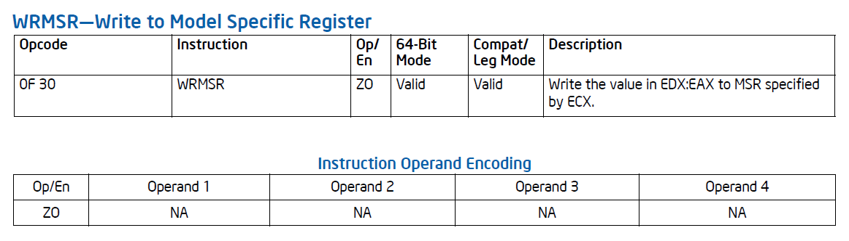
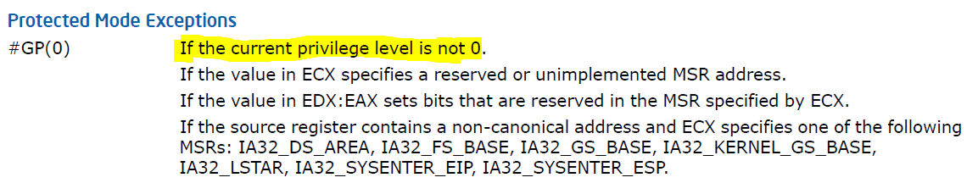
Resource Virtualization - Processor Conditions for ISA Virtualizability
A privileged instruction is defined as one that traps if the machine is in user mode and does not trap if the machine is in system mode
Example: WRMSR, WRGSBASE

Slide 11
Resource Virtualization - Processor Conditions for ISA Virtualizability
To specify instructions that interact with hardware, three categories of special instructions are defined
Control-sensitive instruction
Attempt to change the configuration of resources in the system
For example WRMSR
Behavior-sensitive instruction
Behavior or results produced depend on the configuration of resource
For example Pop Stack into Flags Register (POPF)
Innocuous instruction
An instruction which is neither control sensitive or behaviour sensitive
Notes:
LRA takes a virtual address, translates it, saves the corresponding real address in a specified general-purpose register and The behavior of this instruction depends on the state(mapping) of the real memory resource
POPF pops the flag registers from a stack held in memory. In user mode, this instruction overwrites all flags except the interrupt-enable flag. For the interrupt-enable flag, the instruction acts as a no-op when executed in user mode.

Slide 12
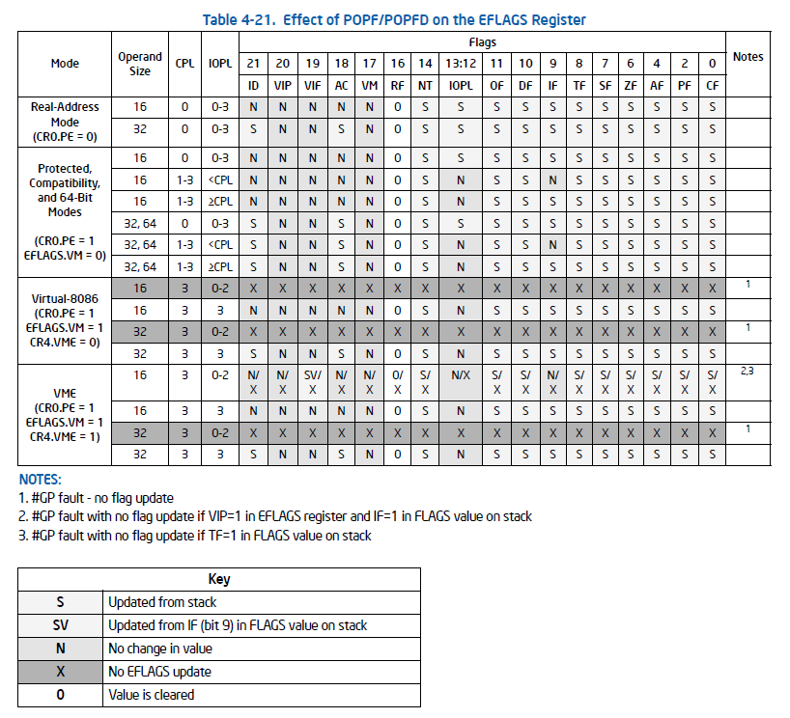
Intel x86 POPF instruction

Slide 13
Handling Problem Instructions
The POPF in IA32 instruction is sensitive but not privileged
It is a critical instruction ( sensitive but not privileged )
It does not generate a trap in user mode
It violate the virtualizability condition of Theorem 1
An additional set of steps must be taken in order to implement a system virtual machine (with possible loss of some efficiency )
It is possible for a VMM intercepts POPF and other critical instructions if all guest software were interpreted instruction by instruction

Slide 14
Processor Virtualization in IA-32
IA-32 architecture is not efficiently virtualizable
There are 17 instructions that are critical (sensitive, but not privileged)
The VM needs to be hybridized
Runs natively, but needs scanning and patching of critical instructions first

Slide 15
IA-32 Critical Instructions
The 17 critical instructions fall into 2 broad categories:
Protection system references – instructions that reference the storage protection system, memory system, or address relocation system
E.g., mov ax, cs in user mode generates a no-op
Sensitive register instructions – instructions that attempt to read or change resource-related registers and memory locations
E.g., popf, which could potentially change IF flag

Slide 16
Resource Virtualization – Processor Handling Problem Instructions
The VMM scans the guest code stream to discover all critical instructions and replace them with a trap or jump to VMM
The process above is called patching

Slide 17
Resource Virtualization – Processor Handling Problem Instructions
Patching
Code patch for
Discovered
Critical instruction
Control transfer,
e.g., trap
Scanner and
Patcher
VMM

Slide 18
Resource Virtualization – Processor Patching of Critical Instructions
One way to discover critical instructions
The VMM takes control at the head of each guest basic block and scan instructions in sequence until the end of the basic block is reached
If a critical instruction is found, it is replaced with a trap to the VMM
Another trap back to the VMM is placed at the end of the basic block
To reduce overhead, the trap at the end of a scanned basic block can be replaced by the original branch or jump instruction
Notes:
In order to further reduce overhead, instead of scanning single basic locks at a time, the VMM can scan through all branches that allow target computation. Thus for a conditional branch. Both the fall-through as well ass the taken branch paths are followed during the initial scan, and this process is repeated until a control-transfer instruction is encountered.
Observe that a critical instruction appearing in a guest application program needs to be patched only if it causes some action to be taken when performed in user mode.

Slide 19
Resource Virtualization – Processor Caching Emulation Code
Reduce the overhead of VMM interpretation when the frequency of sensitive instructions requiring interpretation is high
Specialized
Emulation Routines
Code section
Emulated in code
cache
Block 1
Control
Transfer,
e.g., trap
Block 1
Block 2
Translation
Table
Code Cache
Block 3
Block 3
Block 2
Two critical
Instructions combined
Into a single block
Patched Program
VMM
Notes:
The cached code is an emulation of an entire block of the original code, including the critical instruction, and hence is specific to the location of the trapping instruction.
When the VMM returns control to the virtual machine, it restores the program counter to the point immediately after the block that was emulated rather than to the instruction following the trap

Slide 20
Conditions for ISA Virtualizability
Component of a Virtual Machine Monitor :
Dispatcher, Allocator and
Interpreter routines
Instruction
Trap occurs
dispatcher
These instructions
desire to change
machine reosurce,
e.g., load relocation
bounds register
Privileged
instruction
Interpreter
routine1
Privileged
instruction
Allocator
Privileged
instruction
Interpreter
routine1
Privileged
instruction
Interpreter
routine1
These instructions do not
change machine resources
But access privileged
resource, e.g., IN, OUT,
Write TLB
Notes:
The dispatcher is the top level control module of the VMM, which decides the next module to be invoked.
The dispatcher is invoked by the interrupt handler when the hardware traps
The allocator decides how system resources are to be allocated
The allocator is invoked by the dispatcher whenever there is a need to change machine resources associated with virtual machine
In a well-constructed VMM, any instruction that attempts to change resource assignments or whose behavior is affected by the assignment of resources will trap to the VMM dispatcher
The trapping instruction that attempt to change resource assignment are then directed by the dispatcher to the allocate while the rest of the traps will be directed to the interpreter routine

Slide 21
Popek and Goldberg Virtualization Requirements
A potential virtual machine must satisfy three properties
Efficiency
Resource control
Equivalence
Theorem 1 regarding (efficient) VMM construction
A virtual machine monitor may be constructed if the set of sensitive instruction is a subset of the set of privileged instructions
It means that an efficient virtual machine implementation can be constructed if instructions that could interfere with the functioning of the VMM always trap in the user mode
Notes:
Efficiency implies that all instructions that are innocuous must be executed natively on the hardware
Resource control implies that it should not be possible for guest software to directly change the configuration of any system resources available to it, e.g. real memory. The allocator must be invoked in case the guest software attempt to make any changes
Equivalence implies that any program executing on a virtual machine must behave in a manner identical to the way it would have behaved when running on the native hardware, with only a few exceptions.
All non privileged instruction do not need any emulation and can be executed natively on the host platform

Slide 22
Resource Virtualization - Processor Conditions for ISA Virtualizability
The VMM interprets a sensitive instruction according to the prevailing status of the virtual system resources and the state of the virtual machine
Guset OS code in VM
(user mode)
VMM code
(privileged mode)
Privileged instruction(LPSW)
Dispatcher
LPSW Routine:
Change mode to privileged
Check privilege level in VM
Emulate instruction
Compute target
Restore mode to user
Jump to target
Next instruction(target of LPSW)
Notes:
The privileged instruction causes a trap because the guest OS is operating in user mode. The trap goes to the dispatcher in the VMM, from where it is directed to the special interpreter routine for the specific instruction
Guest OS run in user mode and the VMM run in the system mode
There is checking in VMM to ensure the execution of the routine is safe

Slide 23
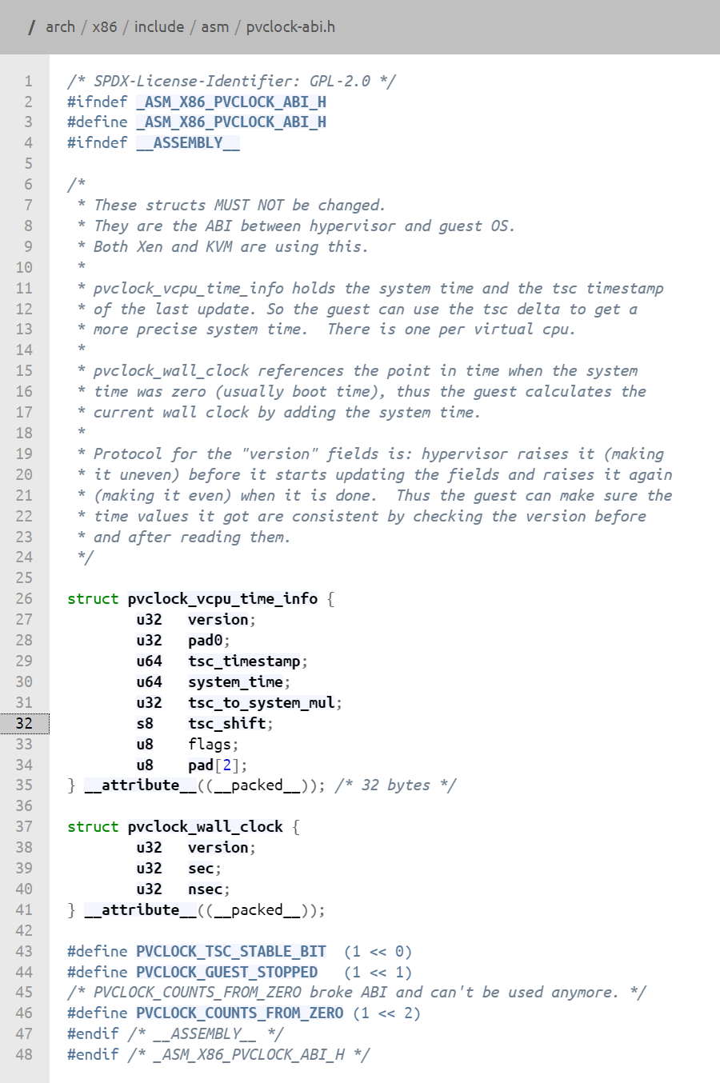
A particularly nasty issue: keeping time
How to create the illusion of virtual continuous time?
Solution: to adjust for the difference
Example: the pvclock protocol of Linux
A simple per-CPU structure that is shared between the host and the guest
To get the current timestamp counter (TSC) reading, guests must do:

Slide 24
Resource Virtualization – Processor Recursive Virtualization
The concept of running the virtual machine system on a copy itself
Two effects that usually restrict the ability to create an efficient recursively virtualizable system
Timing dependancies
Memory allocation
Virtual
Machine
Virtual
Machine
Virtual
Machine
Virtual
Machine
2nd-level VMM
Nonprivileged
Mode
VMM
Privileged
Mode
hardware

Slide 25
Processor Recursive Virtualization
Theorem 2
A conventional (third-generation) computer is recursively virtualizable if
it is virtualizable and
a VMM without any timing dependences can be constructed for it
“Timing dependences” = none of the instructions’ execution depends on timing constraints, i.e., no real-time-ness

Slide 26
Resource Virtualization – Input/Output Virtualizing Device
Dedicated Devices
Some I/O device is dedicated to a particular guest VM or at least are switched from one guest to another on a very long time scale
The device itself does not necessarily have to be virtualized
Requests to and from the device could theoretically bypass the VMM and go directly to the guest operating system
Partitioned Device
A very large disk, for example, can be partitioned into several smaller virtual disk that are then made available to the virtual machine as dedicated devices

Slide 27
Resource Virtualization – Input/Output Virtualizing Device
Shared Devices
Some device, such as a network adapter, can be shared among a number of guest VMs at a fine time granularity
Each guest may have its own virtual state related to usage of the device, e.g., a virtual network address.
This state information is maintained by the VMM for each guest VM
Nonexistent Physical Device
Virtual devices “attached” to a virtual machine for which there is no corresponding physical device
For example, a network adapter that is used for communicating with other virtual machines on the same platform

Slide 28
Resource Virtualization – Input/Output Virtualizing Device
Spooled Device
Virtualization of spooled device can be performed by using a two-level spool table approach
Virtual Machine 1 Spool Table
Program
Status
Location
Real loc
Size
10000
A
Printed
1000
11000
400
B
Completed
2000
12000
200
C
Running
3000
13000
200
D
Completed
4000
14000
500
Virtual Machine 2 Spool Table
Program
Status
Location
Real loc
Size
20000
P
Running
1000
21000
400
Q
Completed
2000
22000
800
VMM Spool Table
VM
Status
Status
Real loc
Size
30000
1
A
Printed
30000
400
2
Q
Printing
31000
800
1
B
Waiting
31800
200
1
D
Waiting
30400
500

Slide 29
Resource Virtualization – Input/Output Virtualizing I/O Activity
An application program makes device-independent I/O request
The Operating system converts the device-independent request into calls to device driver routines
A device driver takes care of device-specific aspects of performing an I/O transaction
The VMM can intercept a guest’s I/O action and convert it from a virtual device action to a real device action at any of the three interface
The system call interface
The device driver interface
The operational-level interface
Application
System calls
Operating system
driver calls
VMM
I/O drivers
Physical memory and I/O operations
Hardware

Slide 30
Resource Virtualization – Input/Output Virtualizing I/O Activity
Virtualizing at the I/O operation Level
The privileged nature of the I/O operations make them easy for the VMM to intercept because they trap in user mode
Virtualizing at the Device Driver Level
If the VMM can intercept the call to the virtual device driver, it can convert the virtual device information to the corresponding physical device and redirect the call to a driver program for the physical device
It requires that the VMM developer have some knowledge of the guest operating system and its internal device driver interfaces
Virtualizing at the System call Level
The virtualization process could be made more efficient by intercepting the initial I/O request at the OS interface, the ABI. Then the entire I/O action could be done by the VMM

Slide 31
Input / Output Virtualization and Hosted Virtual Machines
An I/O request from a guest virtual machine is converted by the native-mode portion of the VMM into a user application request made to the host
An advantage of a hosted virtual machine
It is not necessary to provide device drivers in the VMM
the actual device drivers do not have to be incorporated as part of the VMM

Slide 32
Input / Output Virtualization and Hosted Virtual Machines
A component that form a dual mode hosted virtual machine system
VMM-n(native)
Intercepts traps due to privileged instructions or patched critical instructions encountered in a virtual machine
VMM-u(user)
Makes resource requests to the host OS
VMM-d(driver)
Provide a means for communication between the other two components

Slide 33
Memory Virtualization

Slide 34
Virtual Memory for System VMs
“Any programming problem can be solved by adding a level of indirection.”
Anonymous

Slide 35
“Any programming problem can be solved by adding a level of indirection.”
Anonymous
“Any performance problem can be solved by removing a level of indirection.”
M. Haertel

Slide 36
Implementation
Translation Lookaside Buffer is used to cache locations of frequently-accessed pages
“Architected Page Table” ➔ Hardware maintains page table & instructions regarding it are part of the ISA. The TLB is invisible to ISA and OS.
“Architected TLB” ➔ Instructions to manipulate TLB are part of the ISA. OS implements the page table (hardware is unaware) More recent.

Slide 37
Implementation
Virtual Page
Physical Page
Architected Page Tables
Guest OS manages virtual-to-real mappings for its processes.
VMM manages virtual-to-physical mappings in a Shadow Page Table, and virtualizes the page table pointer. Instructions to modify this trap & the VMM updates guest’s page table pointer.
------
------
1,000
1,000
------
------
Page Table Pointer
2,000
500
------
------
P1V1
Program 1 on VM1
P1V2
Virtual Page
Physical Page
P2V1
------
------
P2V2
1,000
not mapped
P3V2
------
------
…
4000
not mapped
------
------
Program 2 on VM1

Slide 38
Hardware support for virtualization
Intel Virtualization Solution
Source: Y. Chung, National Tsinghua University, Taiwan

Slide 39
What is needed
CPU Virtualization: Intel VT-x
Memory Virtualization: Extended Page Tables (EPT)
IO Virtualization: Intel VT-d

Slide 40
Trap and Emulate Model
We want CPU virtualization to be efficient
We should make guest binaries run on CPU as fast as possible.
Theoretically speaking, if we can run all guest binaries natively, there will NO overhead at all.
But we cannot let guest OS handle everything, VMM should be able to control all hardware resources.
Solution :
Ring Compression
Shift traditional OS from kernel mode(Ring 0) to user mode(Ring 1), and run VMM in kernel mode.
Then VMM will be able to intercept all trapping event.

Slide 41
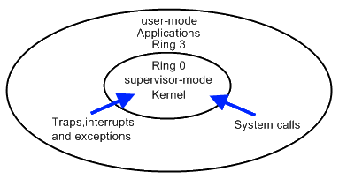
Trap and Emulate Model
VMM virtualization paradigm (trap and emulate) :
Let normal instructions of guest OS run directly on processor in user mode.
When executing privileged instructions, hardware will make processor trap into the VMM.
The VMM emulates the effect of the privileged instructions for the guest OS and return to guest.

Slide 42
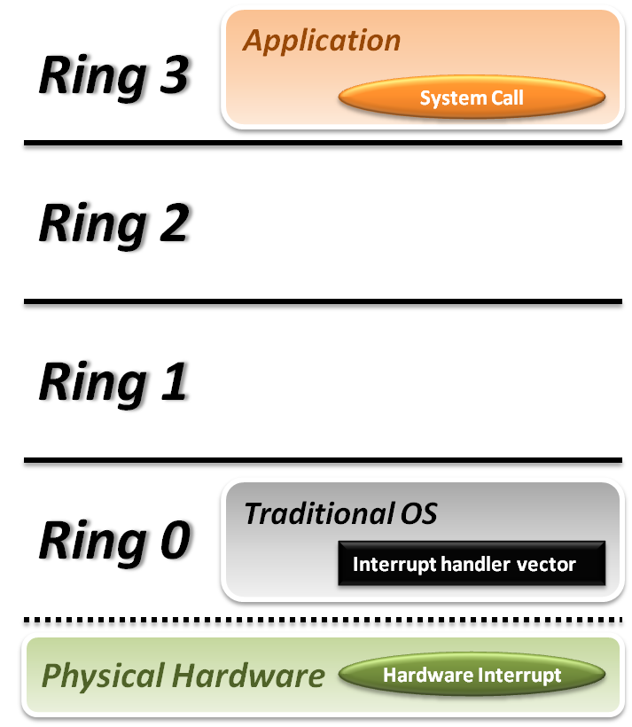


Trap and Emulate Model
Traditional OS :
When application invoke a system call :
CPU will trap to interrupt handler vector in OS.
CPU will switch to kernel mode (Ring 0) and execute OS instructions.
When hardware event :
Hardware will interrupt CPU execution, and jump to interrupt handler in OS.

Slide 43
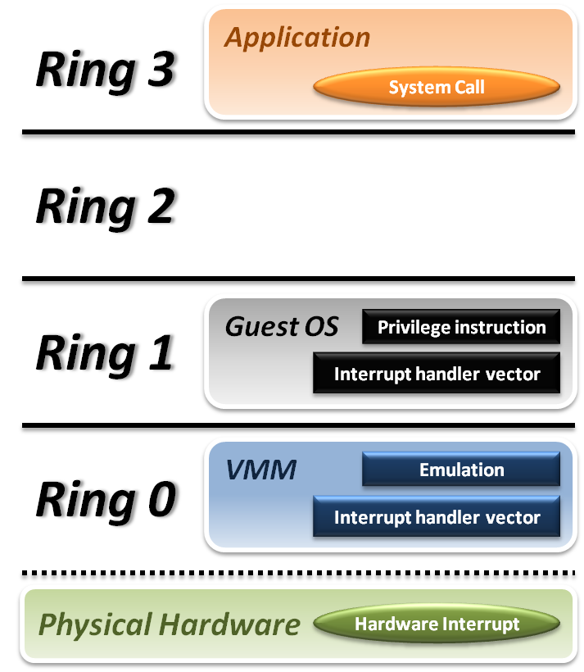






Trap and Emulate Model
VMM and Guest OS :
System Call
CPU will trap to interrupt handler vector of VMM.
VMM jump back into guest OS.
Hardware Interrupt
Hardware make CPU trap to interrupt handler of VMM.
VMM jump to corresponding interrupt handler of guest OS.
Privilege Instruction
Running privilege instructions in guest OS will be trapped to VMM for instruction emulation.
After emulation, VMM jump back to guest OS.

Slide 44
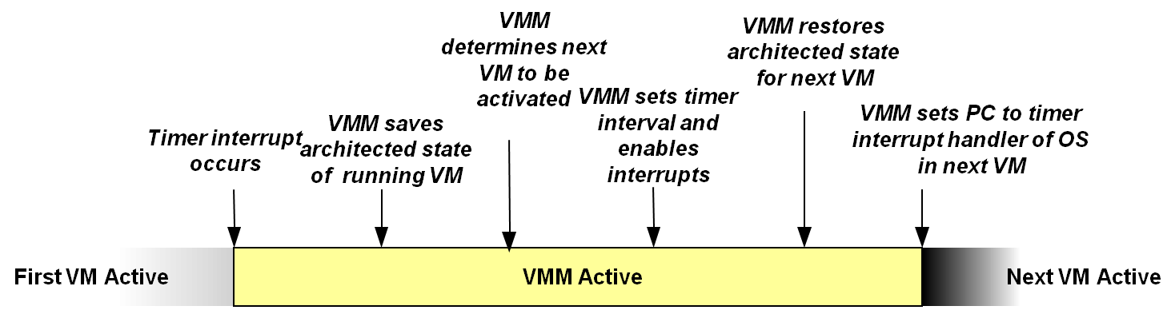
Context Switch

Slide 45
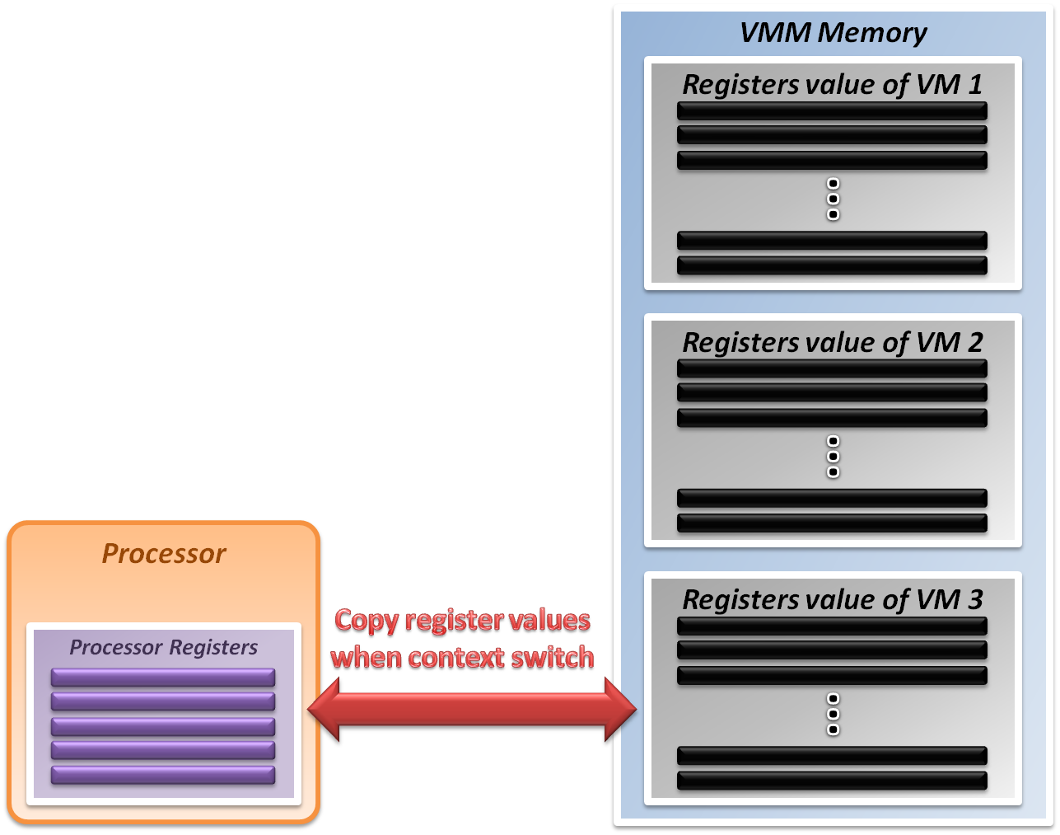
System State Management
Virtualizing system state :
VMM will hold the system states of all virtual machines in memory.
When VMM context switch from one virtual machine to another
Write the register values back to memory
Copy the register values of next guest OS to CPU registers.

Slide 46
Intel VT-x
In order to straighten those problems out, Intel introduces one more operation mode of x86 architecture.
VMX Root Operation (Root Mode)
All instruction behaviors in this mode are no different to traditional ones.
All legacy software can run in this mode correctly.
VMM should run in this mode and control all system resources.
VMX Non-Root Operation (Non-Root Mode)
All sensitive instruction behaviors in this mode are redefined.
The sensitive instructions will trap to Root Mode.
Guest OS should run in this mode and be fully virtualized through typical “trap and emulation model”.
See “Changes to Instruction Behavior in VMX Non-Root Operation” in Chapter 25 of the Intel® 64 and IA-32 Architectures Software Developer’s Manual, Volume 3C

Slide 47
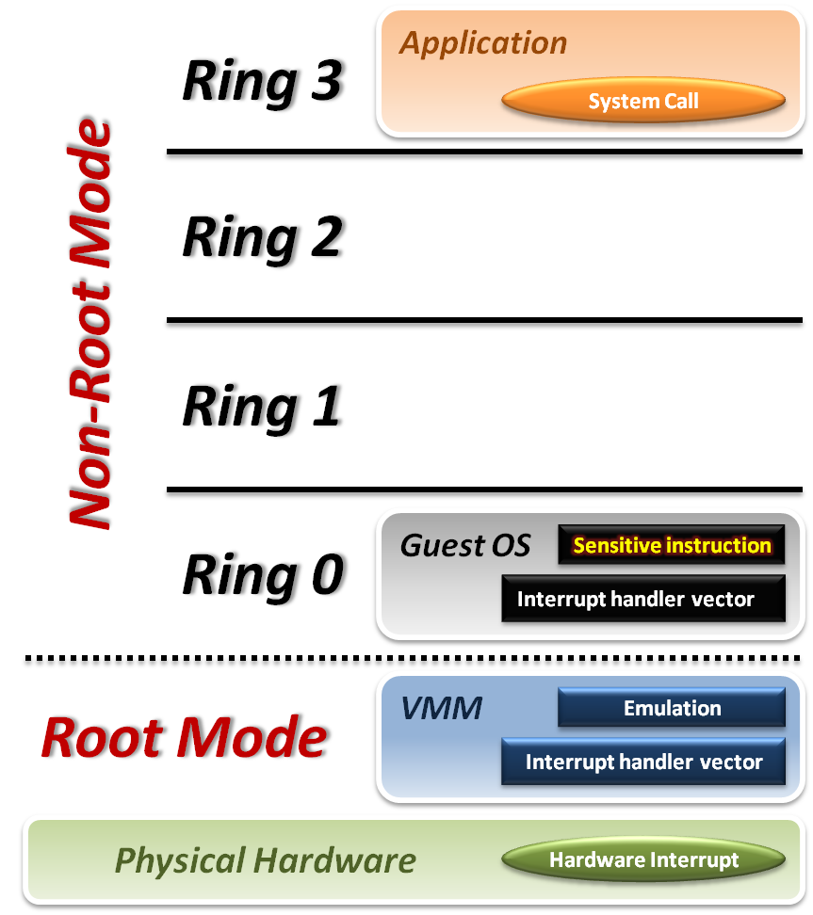





Intel VT-x
VMM with VT-x :
System Call
CPU will directly trap to interrupt handler vector of guest OS.
Hardware Interrupt
Still, hardware events need to be handled by VMM first.
Sensitive Instruction
Instead of trap all privilege instructions, running guest OS in Non-root mode will trap sensitive instruction only.

Slide 48
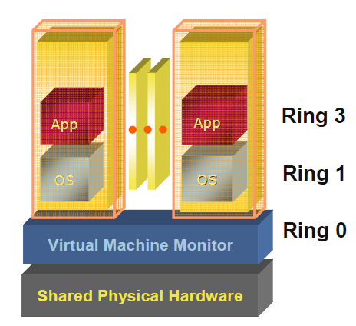
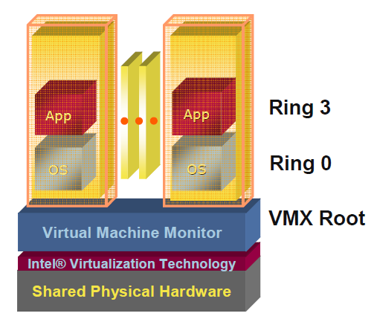
Pre & Post Intel VT-x
VMM de-privileges the guest OS into Ring 1, and takes up Ring 0
OS un-aware it is not running in traditional ring 0 privilege
Requires compute intensive SW translation to mitigate
VMM has its own privileged level
where it executes
No need to de-privilege the guest OS
OSes run directly on the hardware

Slide 49
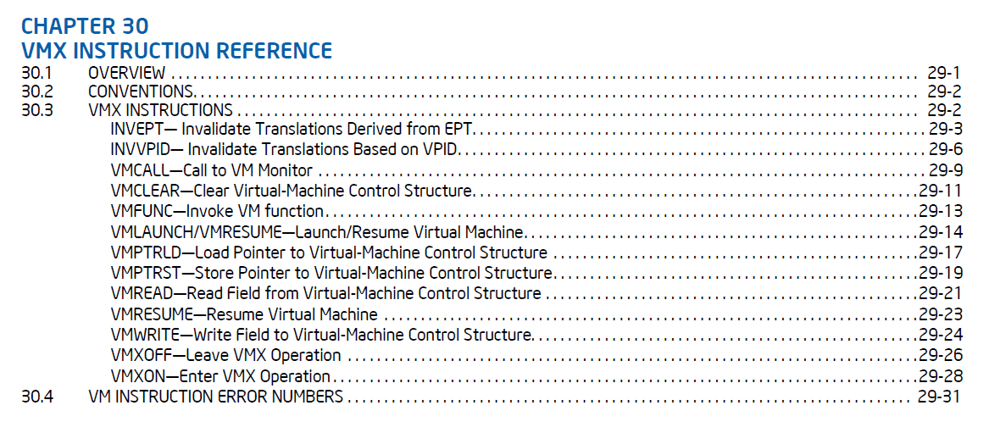
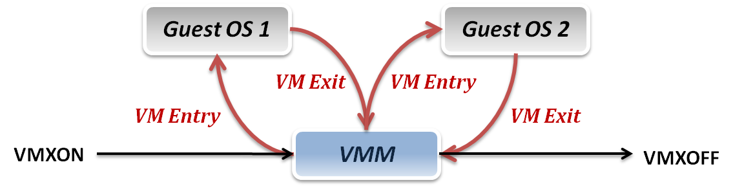
Context Switch
VMM switch different virtual machines with Intel VT-x :
VMXON/VMXOFF
These two instructions are used to turn on/off CPU Root Mode.
VM Entry
This is usually caused by the execution of VMLAUNCH/VMRESUME instructions, which will switch CPU mode from Root Mode to Non-Root Mode.
VM Exit
This may be caused by many reasons, such as hardware interrupts or sensitive instruction executions.
Switch CPU mode from Non-Root Mode to Root Mode.

Slide 50
System State Management
Intel introduces a more efficient hardware approach for register switching, VMCS (Virtual Machine Control Structure) :
State Area
Store host OS system state when VM-Entry.
Store guest OS system state when VM-Exit.
Control Area
Control instruction behaviors in Non-Root Mode.
Control VM-Entry and VM-Exit process.
Exit Information
Provide the VM-Exit reason and some hardware information.
Whenever VM Entry or VM Exit occur, CPU will automatically read or write corresponding information into VMCS.

Slide 51
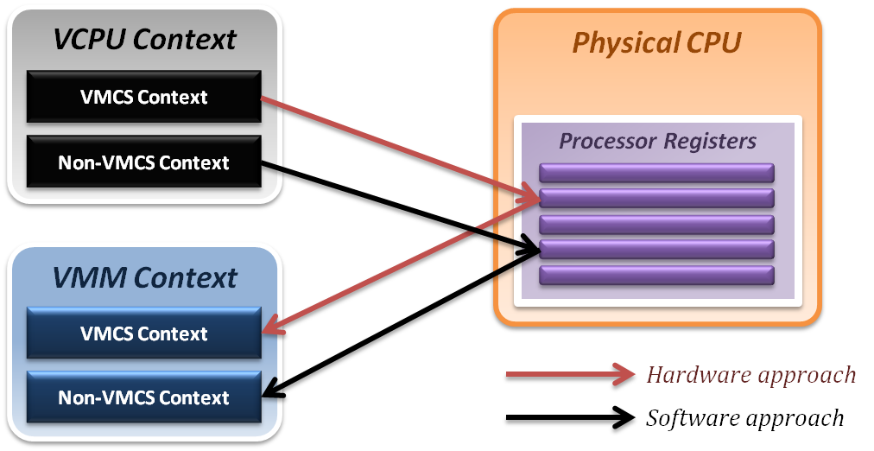
System State Management
Binding virtual machine to virtual CPU
VCPU (Virtual CPU) contains two parts
VMCS maintains virtual system states, which is approached by hardware.
Non-VMCS maintains other non-essential system information, which is approach by software.
VMM needs to handle Non-VMCS part.

Slide 52
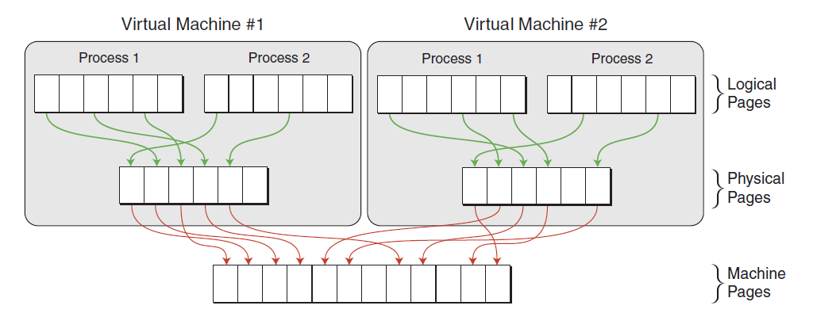
Memory Virtualization: Extended Page Table
Concept of Extended Page Table (EPT) :
Instead of walking along with only one page table hierarchy, EPT technique implement one more page table hierarchy.
One page table is maintained by guest OS, which is used to generate guest physical address.
The other page table is maintained by VMM, which is used to map guest physical address to host physical address.
For each memory access operation, EPT MMU will directly get guest physical address from guest page table, and then get host physical address by the VMM mapping table automatically.

Slide 53
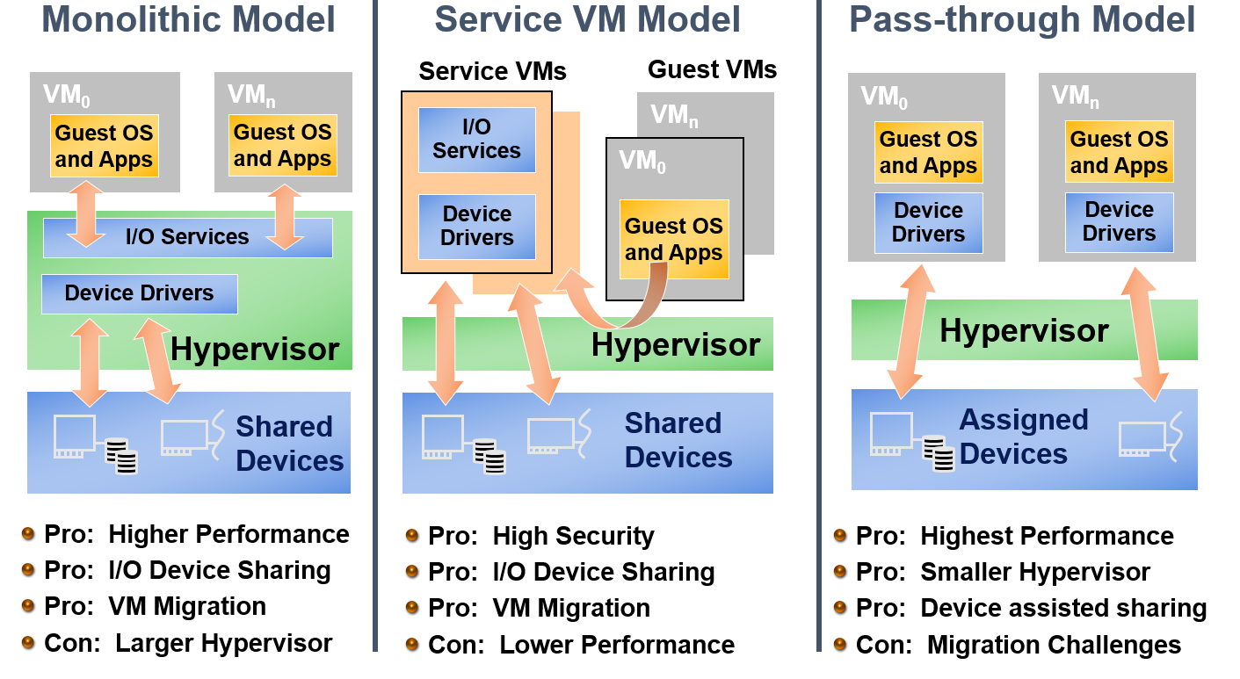
Options For I/O Virtualization
VT-d Goal: Support all Models

Slide 54
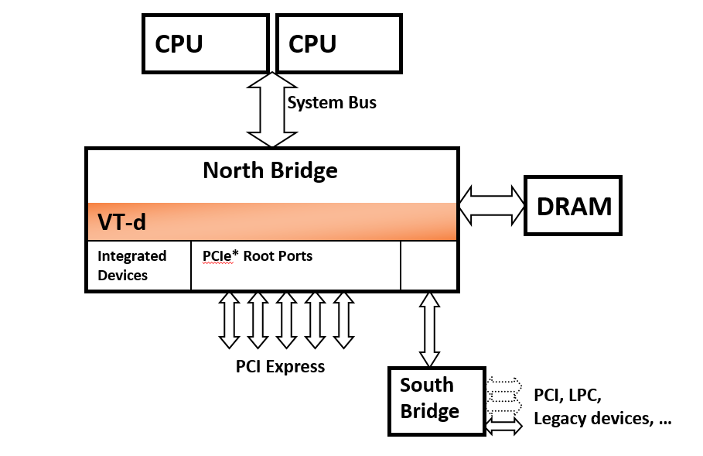
VT-d Overview
VT-d is platform infrastructure for I/O virtualization
Defines architecture for DMA remapping
Implemented as part of platform core logic
Will be supported broadly in Intel server and client chipsets

Slide 55
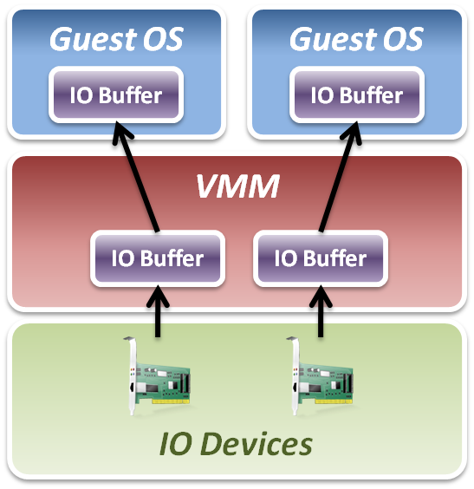
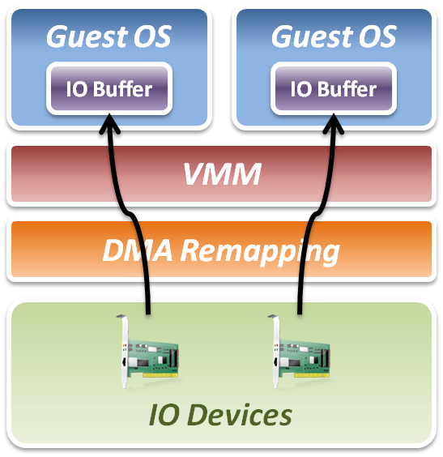
Intel VT-d
Add DMA remapping hardware component.
Software Approach
Hardware Approach

Slide 56
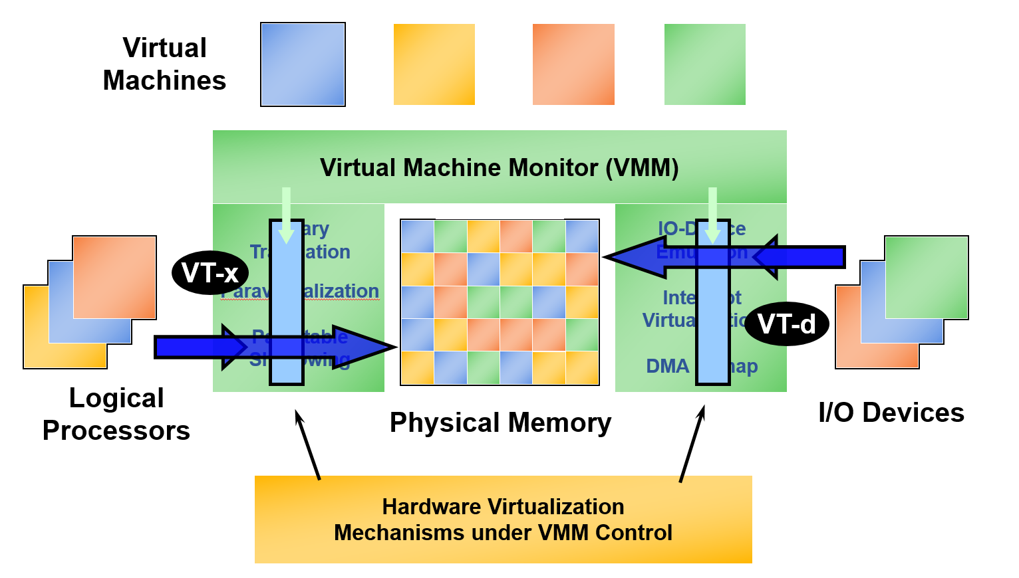
VT-x & VT-d Working Together

Slide 57
Summary
CPU Virtualization
Trap and Emulate Model
Virtualization technique, VMX Root/Non-Root Operation, VMM and Guest OS, VMCS … etc.
Memory Virtualization: Extended Page Tables (EPT)
EPT implement one more page table hierarchy
MMU virtualize, EPT translation, Memory Operation,… etc.
IO Virtualization: Intel VT-d
Implement DMA remapping in hardware
Hardware Page Walk, Translation Caching

Slide 58
Our journey in CS5250

Slide 59
What we have gone through
We (re)visited the traditional OS concepts such as process management, virtual memory etc.
Linked them with actual ISA support
Deep dive into an industrial strength OS
Studied some of the key data structures and algorithms used

Slide 60
What you have achieved
The kernel is no longer some mysterious blackbox
You actually work some kernel code!
Understand the API a bit better
A better appreciation of how it works and the tradeoffs involved
Some issues translate to wider software engineering practices

Slide 61
Looking forward
No doubt the kernel will change
Even as we speak
But not the underlying principles
You will be able to appreciate future changes even better
Hopefully, the experience will make you a better systems person

Slide 62
END

